Slide 1
Timber Lake Camp Database
Carly Rosner
Paul Kalmus
Jared Stack
Nicolette Odenbach
David Jung

Slide 2
Timber Lake Camp

Slide 3
About
Located in Shandaken, NY
7-8 week sleep away camp
Co-Ed
Various activities
International and domestic staff

Slide 4
Background
3 members went to sleep away camp for 9+ summers
Different camps
Thought about what would make our camping experience better

Slide 5
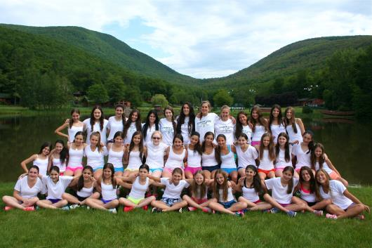
Business Problem
Crazy parents
Scheduling
Placement
End user has no relationship to the campers

Slide 6
Added Business Value
Increased parent satisfaction
Decreased office frustration
No scheduling errors

Slide 7
Database Design
Related tables
Reports
Forms

Slide 8
User Interface Design
Easy to obtain information
Office use vs. head staff use
All necessary information about a camper or counselor

Slide 9
Back-Up Plan
Hand-written files
Duplicate database
MIS Profession

Slide 10
Through the development of the database….
Increased parent satisfaction
Recommend other families
Better customer service

